Slide 1
Portland in 2035
Portland Public Schools
1/15/19

Slide 3
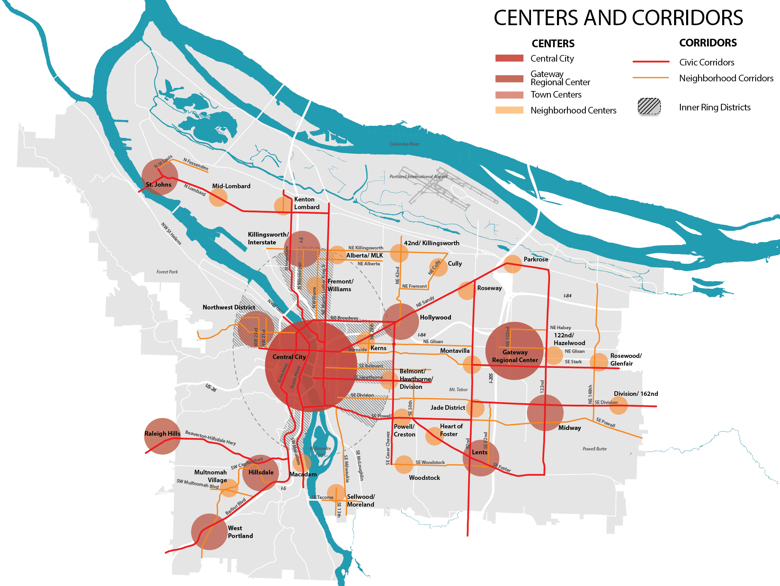
By 2035:
123,000 new households
140,000 new jobs
Percent Growth
30%
50%
20%
Notes:
Diagram to communicate growth strategy policy intent to the
public.
This provides sharper focus to where we grow. The 2040 Plan does not contemplate uncontrolled growth inside the UGB. Portland has hundreds of miles of transit corridors. We have an opportunity to use growth as a tool to achieve more complete healthy connected neighborhoods. Access to transit is important, but not the only
ingredient that goes into creating distinctive high preforming places.
The Urban Design Framework also establishes a common language for different types of places related to their scale –
• Town Centers
• Civic Corridors
• Neighborhood Centers
and Corridors

Slide 4
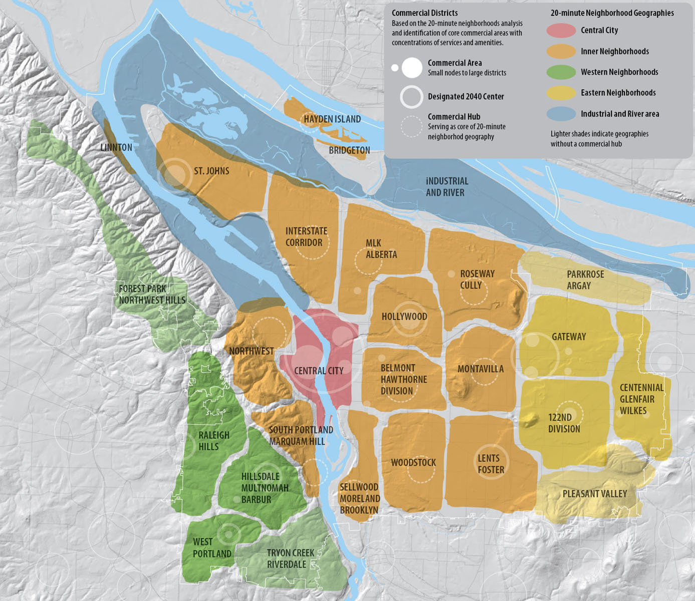
Places and Markets
24 Local Sub-areas
Notes:
Proposed Draft Portland Plan Presentation
November 2011
4
It is important to recognize that not all parts of East Portland or West Portland are the same or have the same issues. In earlier phases of this work, we head that load and clear from the public.
The sub-areas include groups of neighborhoods and generally a commercial core or hub that ties them together. On average, the sub-areas have approximately 11,000 households, but there is some range. The least populous area, Hayden Island, has about 2,500 households and the most populous area, the Central City, has more than 21,000 households.
As we move forward, we’ll see how the plan is improving conditions in 24 local sub-areas.

Slide 5
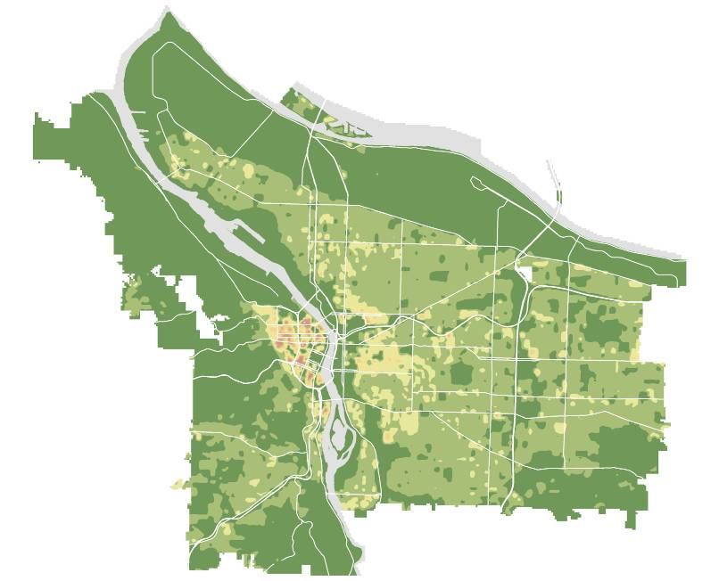
Existing (2010) Households
Notes:
Existing distribution of households – red and yellow areas are more dense.
This shows the same as the other map for the existing distribution of households. Red and yellow areas are more dense.

Slide 6
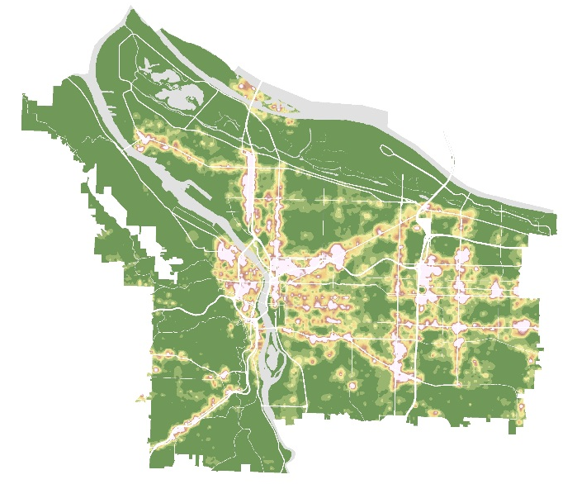
2035 Forecasted Growth
Notes:
And we can see in this map how Portland will look in 2035 in terms of the density of units. This follows the strategy concentrating growth in Centers, Corridors and in the Central City. One way to think of Portland in 2035 in terms of density and bulk is to imagine Northwest District or Hollywood but in more parts of the city.

Slide 7
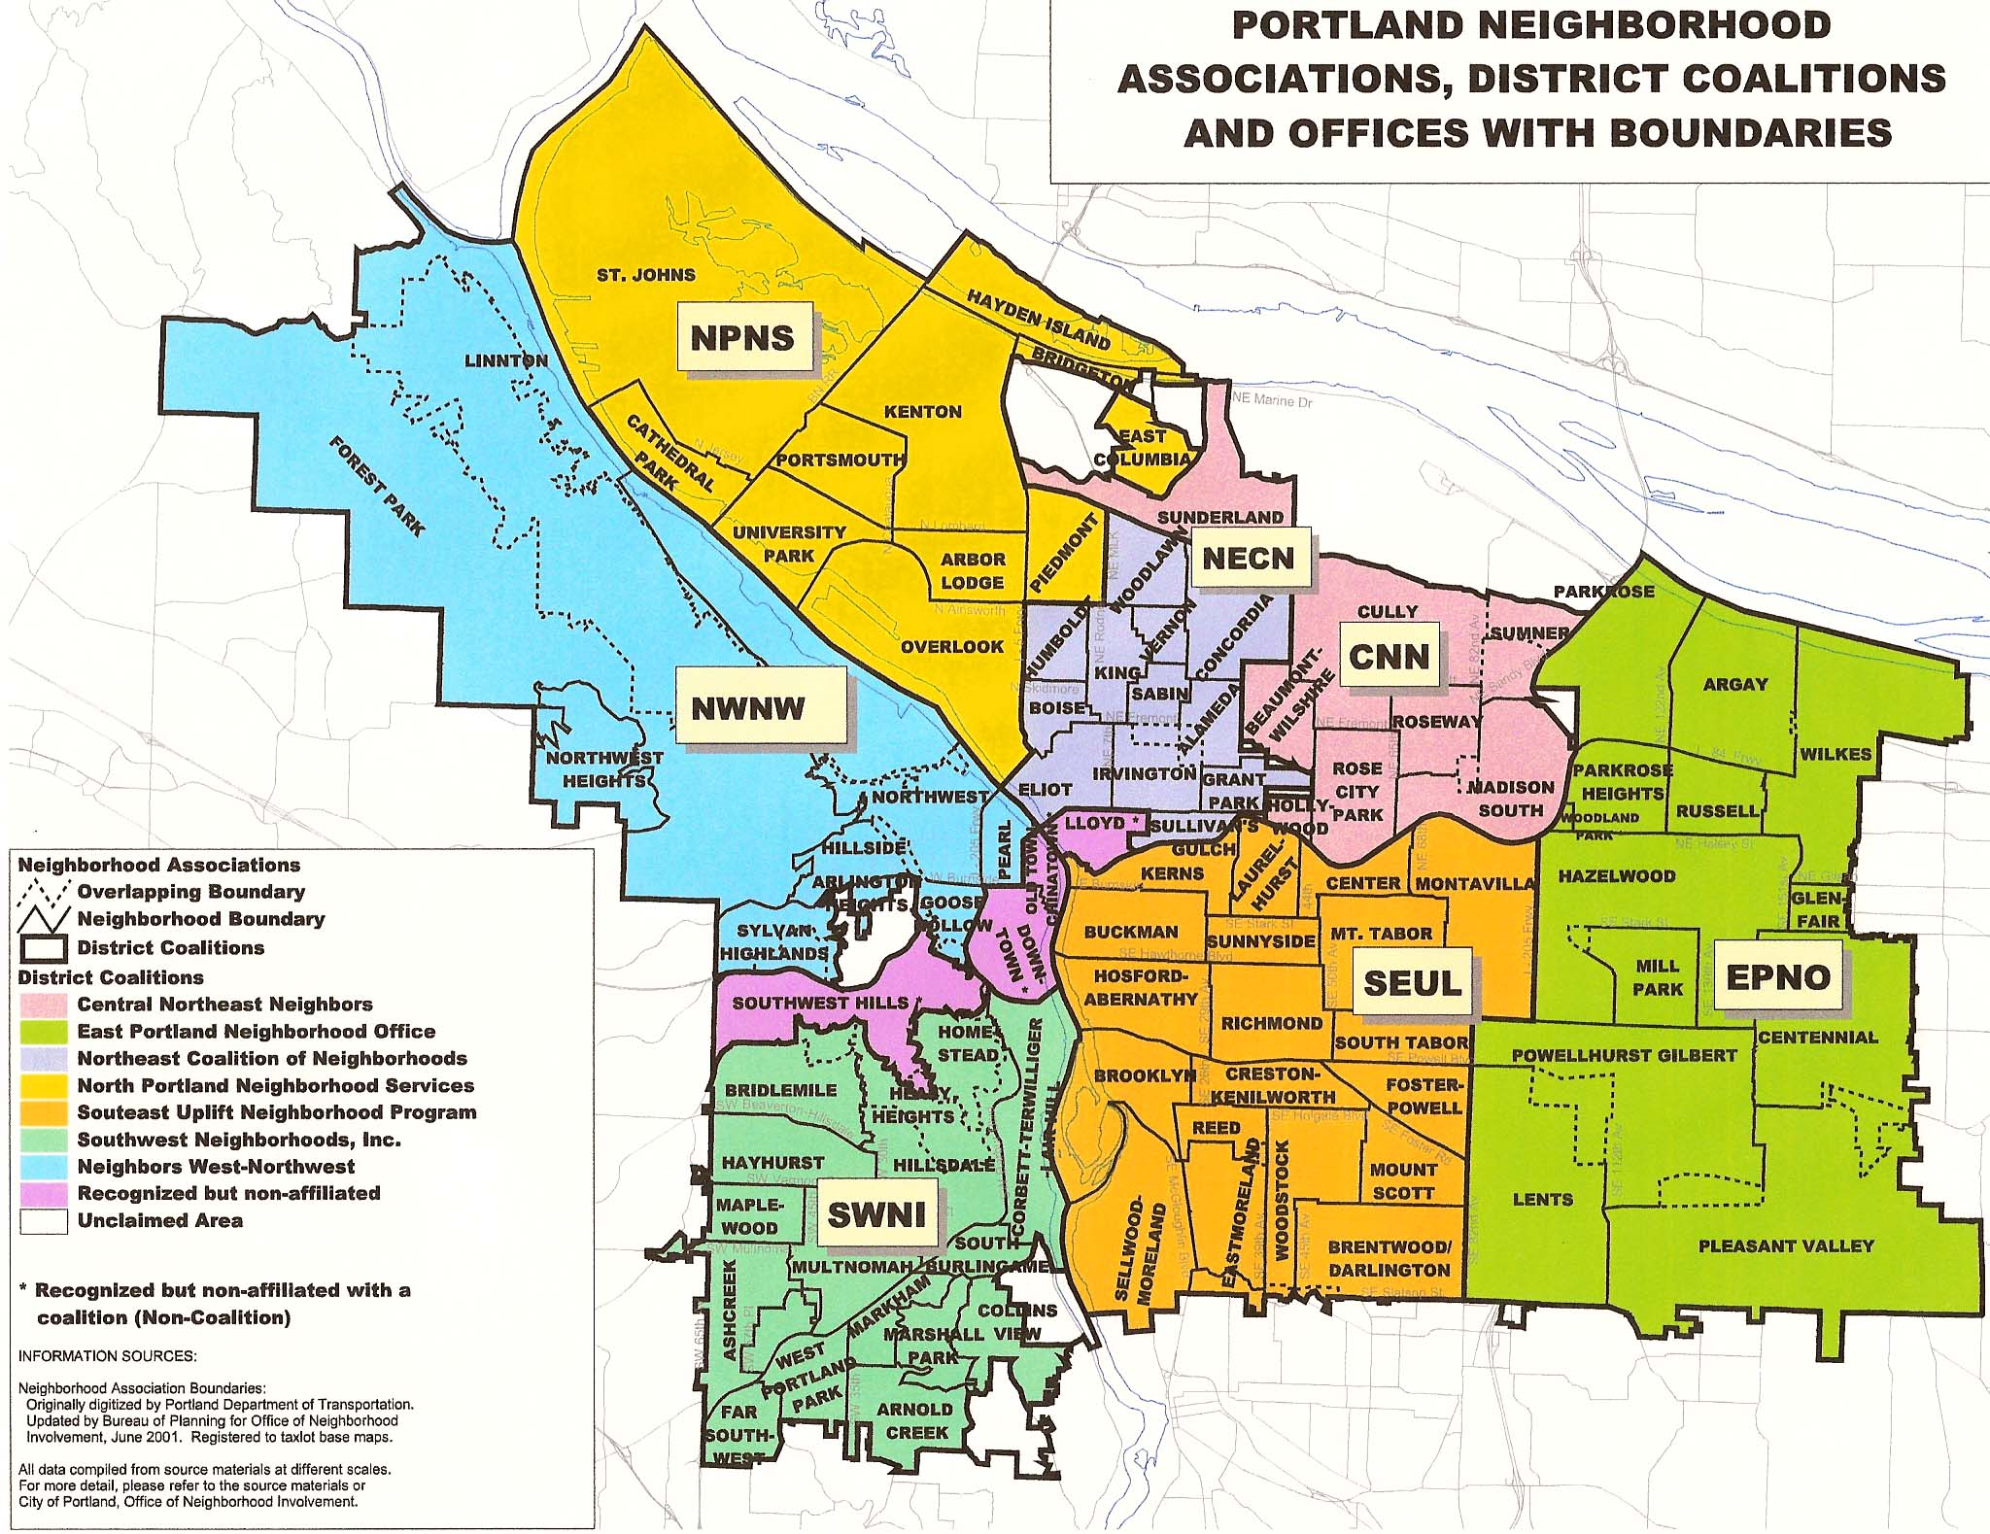

Slide 8
Notes:
We can parse apart the two previous maps into Neighborhood Coalition areas. East Portland will likely see the largest increase in households, adding 25,000 more between now and 2035. SEUL and NWNW both encompass the Central City, and they too will experience a large increase in housing units.

Slide 9
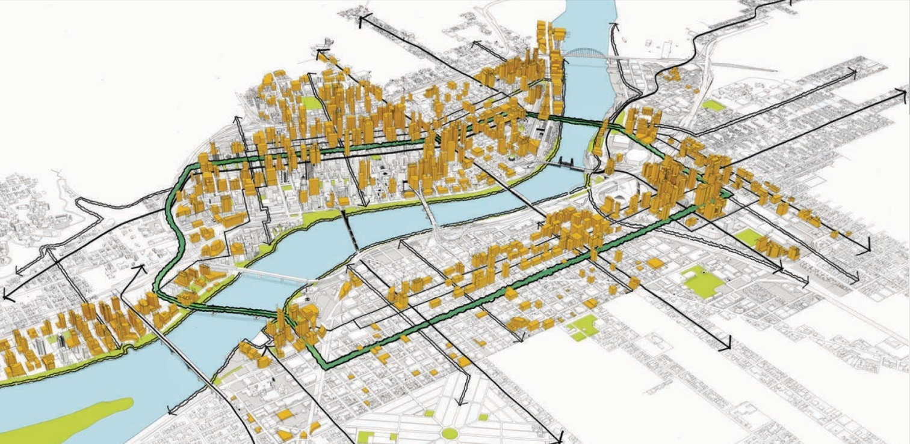
Housing in Central City
Notes:
The Central City will play a major role moving into 2035. Four of the neighborhood coalitions (SEUL, NWNW, SWNI and NECN) contain portions of the Central City, which will almost double in size between 2015 and 2035, absorbing about 40% of all new housing units.

Slide 10
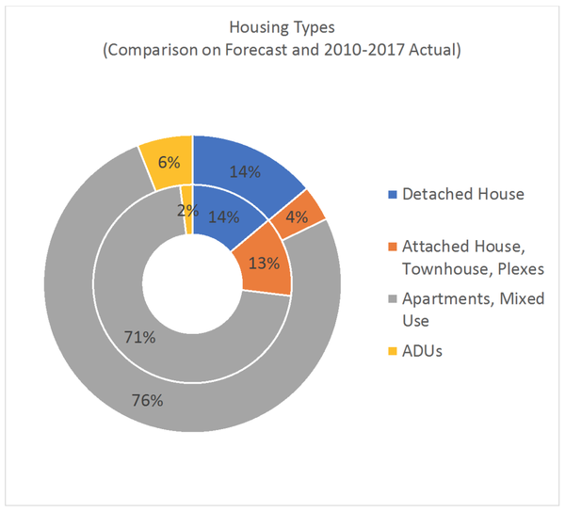

Slide 12
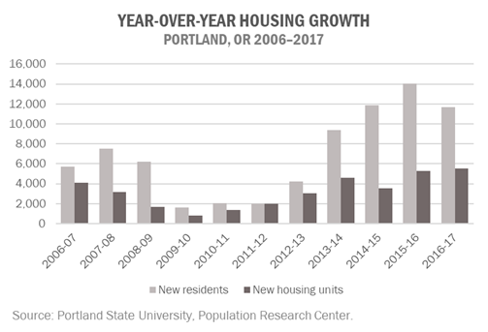

Slide 13
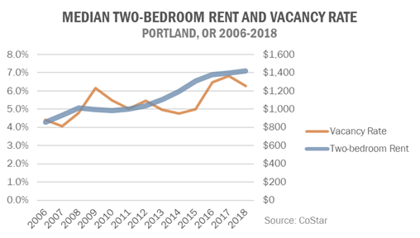

Slide 14
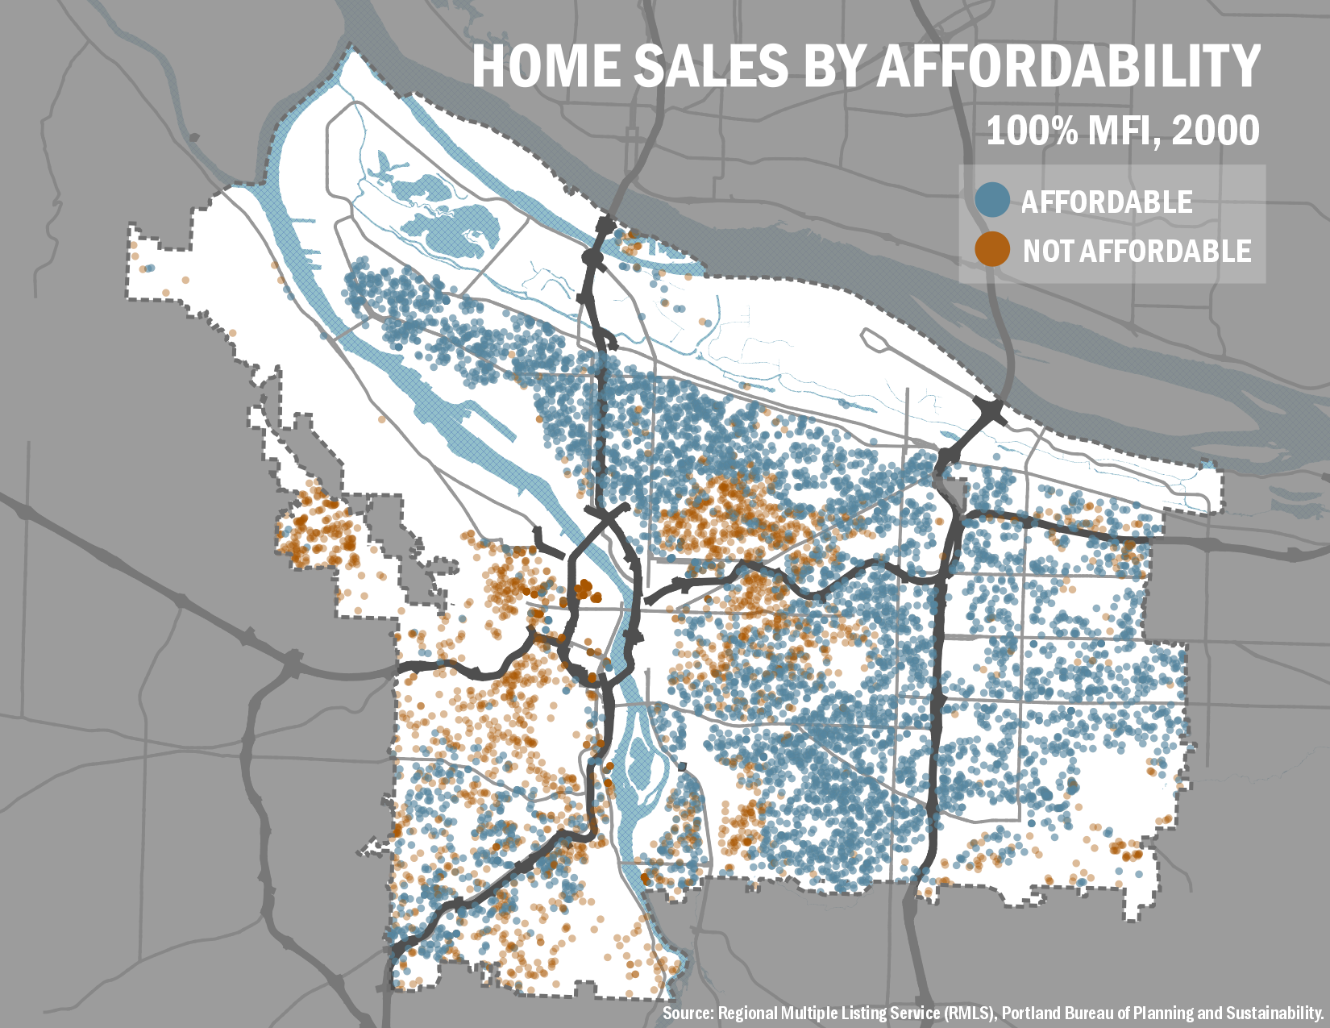
advance slide to begin animation

Slide 15

BPS Policy Framework | 15
Notes:
And, of course, all Portlanders are concerned about affordability.
When we began this project in 2015, Portland had an affordability problem. As our colleagues shared with you two weeks ago, this map shows the home sales that occurred in 2015. The blue dots represent the houses that were affordable to those earning 100% MFI and the brown dots show sales not affordable to those earning 100% MFI.
Take a look at three areas with blue dots. St. Johns, East and along SW Barbur/I-5.

Slide 16
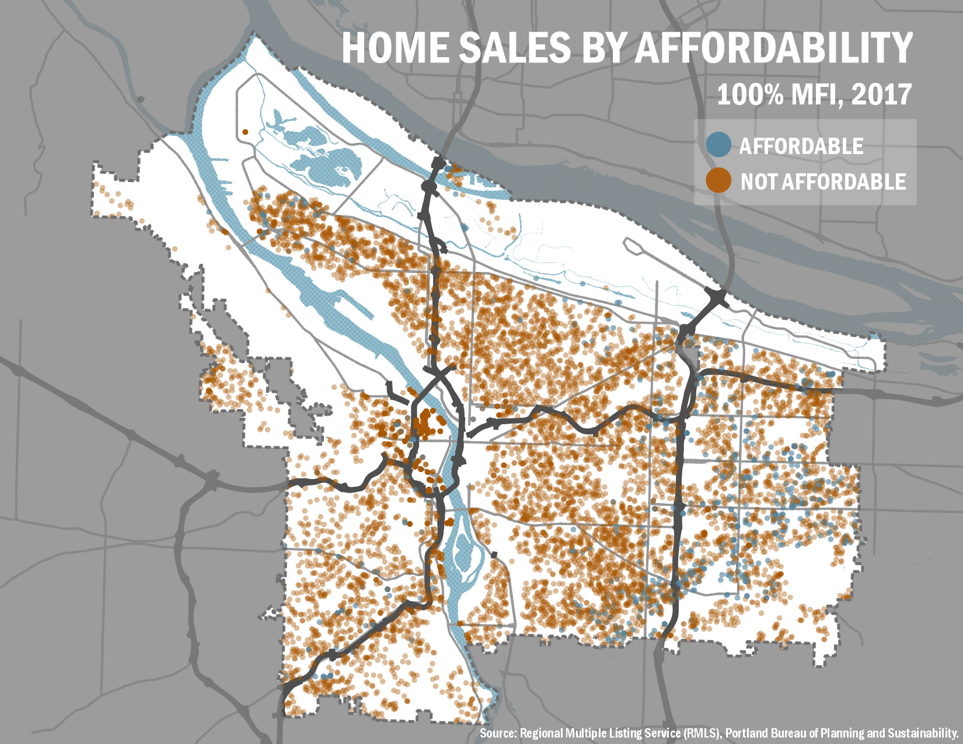
BPS Policy Framework | 16
Notes:
Toggle 2016-2017

Slide 17
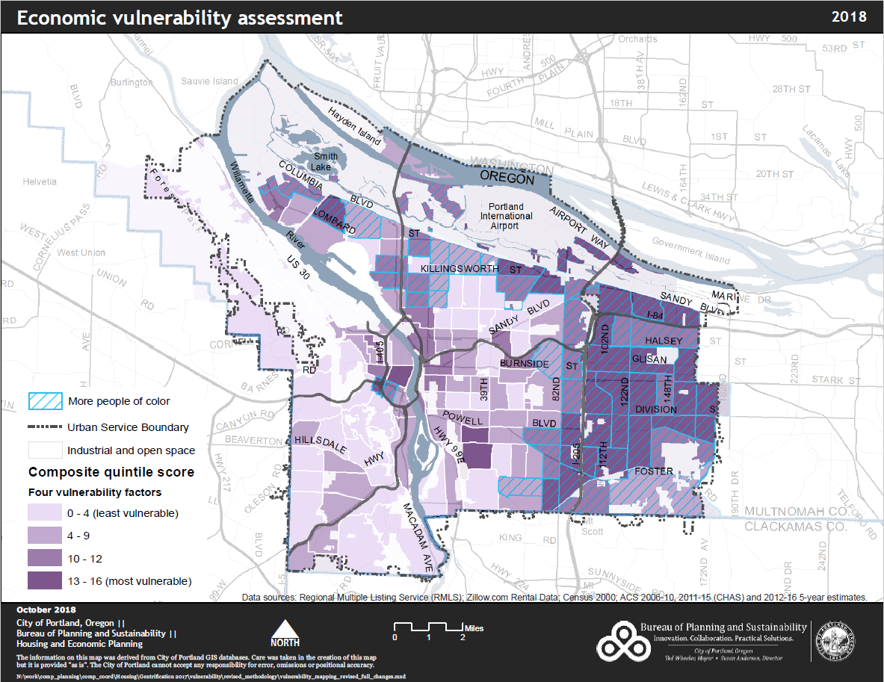
Economic Vulnerability

Slide 18
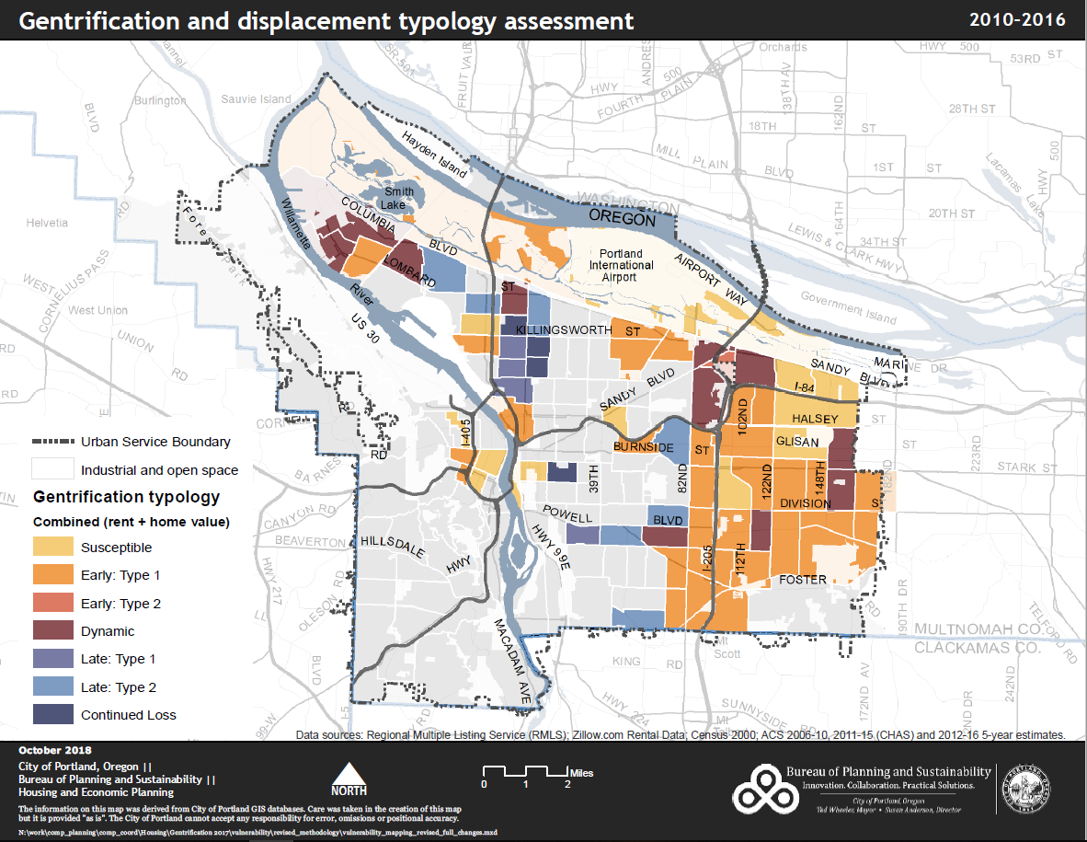
Notes:
Working with Dr. Lisa Bates at PSU, we came up with these indicators that cover who is most at risk of displacement.
BPS has worked with Office of Equity and Human Rights to figure out how to apply this to City decision-making.
Learning from our partners. For example, PBOT has added English Language Proficiency to the indicators.

Slide 19
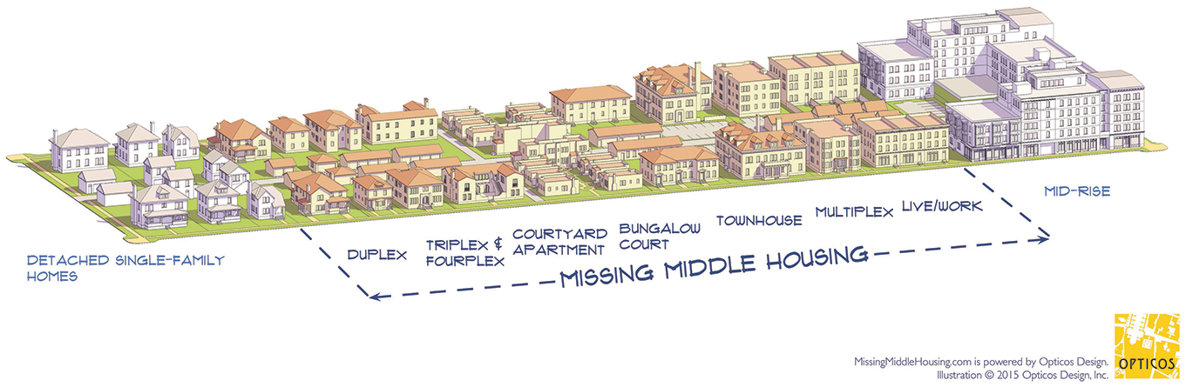
Residential Infill Project
Single-Dwelling Zones
Better Housing by Design
Multi-Dwelling Zones
Mixed Use Zones Project
Commercial/Mixed Use Zones

Slide 20
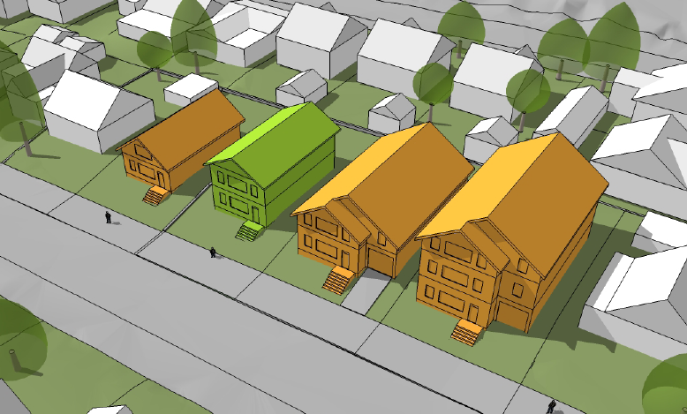
Limit size of house/building, but allow more units…
1,500
SQUARE FEET
2,500
SQUARE FEET
4,400
SQUARE FEET
6,750
SQUARE FEET
AVG.
MAX 2015
MAX possible
Notes:
Shows a range of house sizes on 5,000 s.f. lots
On the left is a typical older Portland home
On the far right is the largest house one can build under today’s code
The largest house built in 2013 was just over 4,400 s.f.
We are proposing a maximum size of 2500 sq.

Slide 21
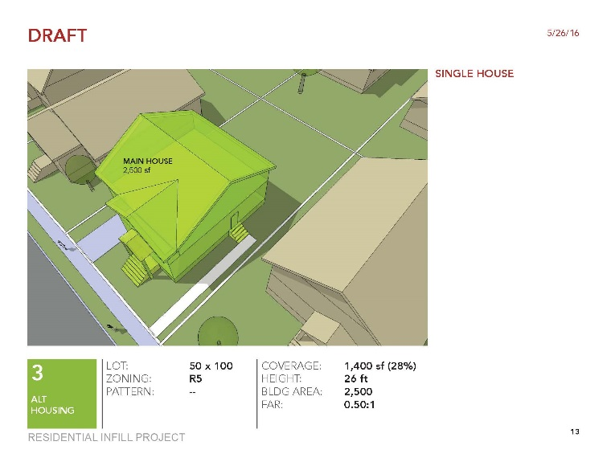
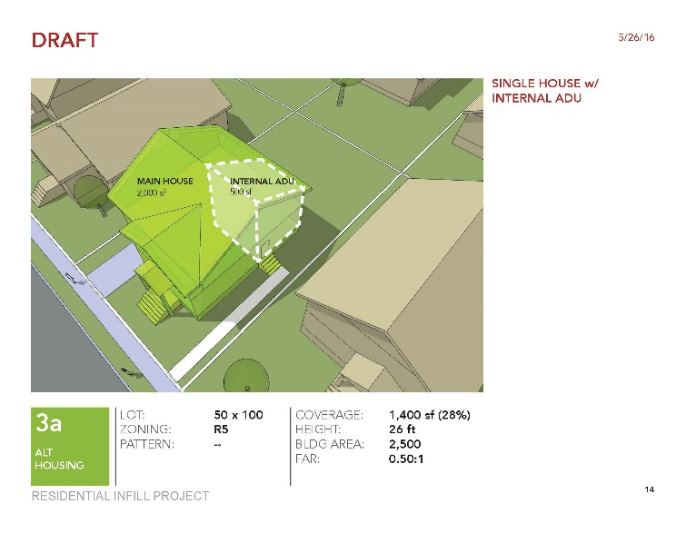
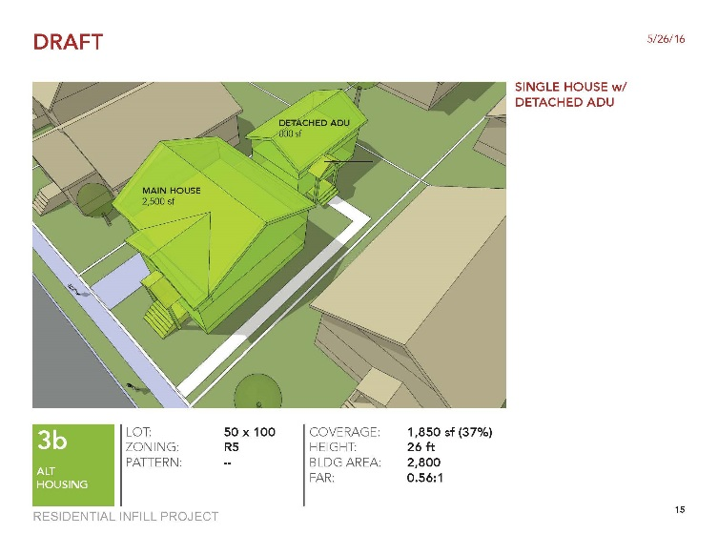
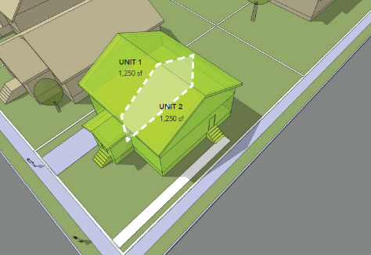



Allowed today…
HOUSE
HOUSE
W/INTERNAL ADU
HOUSE
W/DETACHED ADU
DUPLEX
ON CORNER
1 DU
2 DU
Notes:
Generally, single dwelling zones mean one house per lot.
But there are already some exceptions to this:
In addition to a single house, the code allows a house plus one ADU, and duplexes on corner lots and next to commercial zones.
The proposal would increase this range in select areas by bumping up one unit: house with two ADU’s, duplex on all lots, duplex with an ADU, and triplexes on corners
But the key caveat here is that the size of these structures does not get any larger than what would be allowed for a single house.
Note that while the number of households vary in each of the above examples, the size of the structures is all the same.

Slide 22
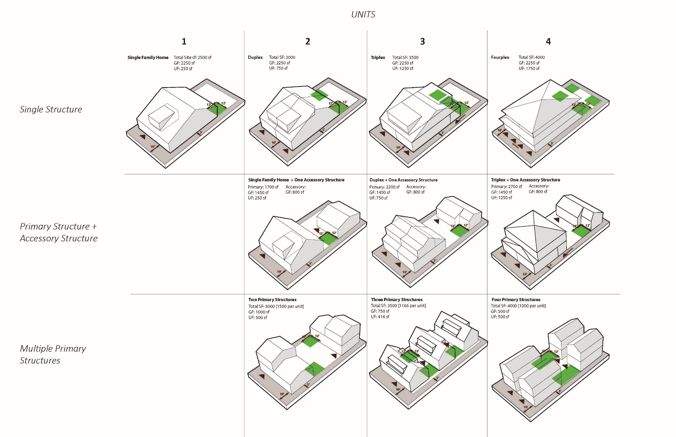
Allowed under the proposal moving forward to City Council…
Add .1 FAR for:
including 1 affordable DU or
preserving existing house
2,500sf
3,000sf
3,500sf
House
House +ADU
Duplex
House + 2 ADU
Duplex +1 ADU
Triplex
Fourplex
1 DU
2 DU
3 DU
4 DU
1 Visitable DU req.
Notes:
The proposal would increase the range of housing types allowed in select single-dwelling zones.
Keep in mind, though, that the balance between affordability and the size/energy consumption balance is dynamic – in order to support the production of more housing, structures are allowed more square footage for additional units (up to four).
Still, the overall size of building that’s allowed– even with 4 units – is less than what’s allowed today for one big house.

Slide 24
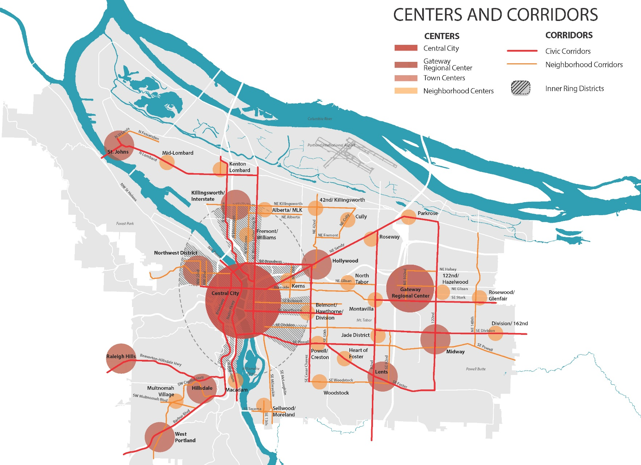
    30%. 50%, 20%
BPS Policy Framework | 24

Slide 25
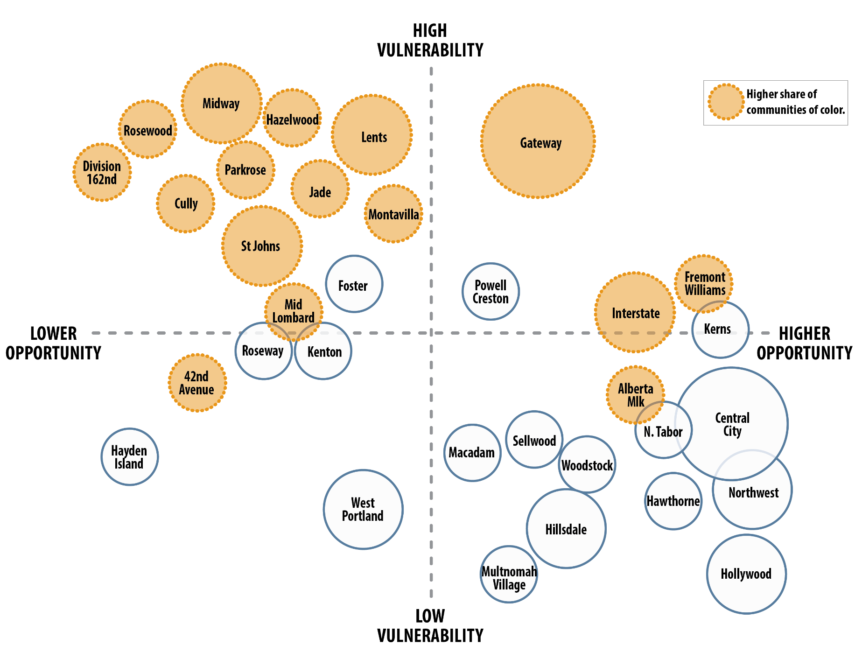
Vulnerability and Opportunity

Slide 26
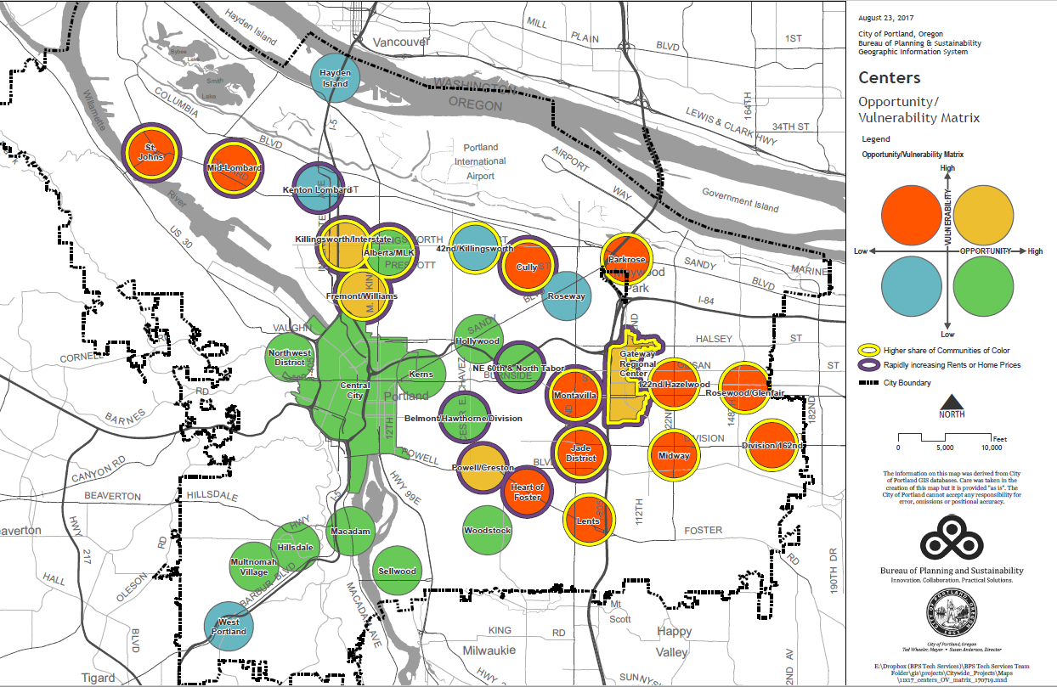
Equitable Investment

Slide 27
Equitable Investment
High
High Vulnerability
Low Opportunity
High Vulnerability
High Opportunity
Prioritize infrastructure investments
Vision Zero safety improvements
NPI program
Affordable housing preservation
Prioritize affordable housing
N/NE Neighborhood Housing Strategy
N Russell/Williams Collaboration
Vulnerability
Low
Opportunity
High
Low Vulnerability
Low Opportunity
Low Vulnerability
High Opportunity
Expand housing choices
Encourage infill through Residential Infill Project and Central City 2035
Expand housing choices
Invest in active transportation improvements to increase mobility
SW Corridor MAX
Low
Notes:
High Vulnerability, Low Opportunity
East Portland, Lents, St Johns
PRIORITY for infrastructure investment to fill gaps with programs like East Portland In Motion or Parks Bureau prioritizing SDC improvement projects in East Portland.
High Vulnerability, High Opportunity
Interstate, Fremont-Williams, Inner Powell
PRIORITIZE affordable housing development and equitable business development
Strategic infrastructure investment
Low Vulnerability, High Opportunity
Central City, Inner Southeast, Hillsdale
PRIORITIZE affordable housing development
Encourage infill – grow our centers and corridors
Strategic infrastructure investment, especially to improve safety and encourage walking, biking and transit
Low Vulnerability, Low Opportunity
West Portland, Kenton, 42nd/Killingsworth
Strategic affordable housing development
Strategic infrastructure investment to increase opportunity, especially to improve safety and increase transportation mobility and connectivity

